Slide 1
New Developer productivity features in Microsoft Dev Box and Azure Deployment Environments
Will Velida
Lead Software Engineer, Mantel Group
@willvelida
June 2024

Slide 2

Whoami?
Lead Software Engineer at Mantel Group
.NET and Azure Developer with experience in banking, agriculture, health, insurance and retail industries.
Former MSFTer and Microsoft MVP.
Former average rugby player.

Slide 3
Why is onboarding hard?
Developer work environment
Procure corporate laptop
Install OS
Find team onboarding wiki
Resolving broken links
Working around out-of-date instructions
Request access to source code
Request access to cloud resources
Application runtime environment
Provide details about the application
Raise a ticket to request a new environment
Find out how to get access to a new test environment
Open & rebuild application to populate caches
Configure local network settings & VPN
Install & configure developer tools & SDK
Clarify requirements with infrastructure teams, e.g., network, security, compliance
Go back and forth to align on requirements
Wait for admins to create and configure infrastructure
Validate whether the app code works on the test environment
Wait for admins to update or fix the infra configuration
Finally get access to the working infrastructure
Repeat the process for a new test environment
Integration Environment…
QA Environment…
Production Environment…
Prod Signoffs…
…

Slide 4

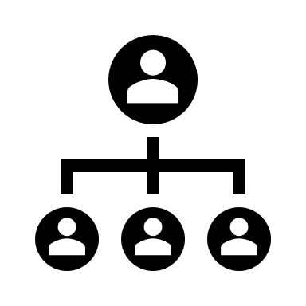






Introduction to Microsoft Dev Box
Platform Engineers
Dev team leads
Developers
Manage dev boxes via Microsoft Intune and Endpoint Manager
Set and manage security policies
Create pools of dev boxes tailored to projects and tasks
Configure dev boxes by project
Customize Developer Experience
Deploy dev boxes they need to work on projects and tasks
Deploy dev boxes from developer portals
Organizational Policies
Network Configuration
Security Policies
Notes:
Dev Box give developers self-services access to cloud workstations called dev boxes. You can configure these dev boxes with tools, source code, prebuilt binaries etc, that are specific to a project so that developers in your team can hit the ground running with their work immediately, so no more needing to wait 2 weeks for someone in security or identity to manually approve your corporate access!
You can use preconfigured images from the Azure Marketplace, or use your own customized images. As a developer, you can use multiple dev boxes for your work, and can access it through remote desktop clients, or web browsers like any virtual desktop.
Dev Box was created with three roles in mind. Platform Engineers, Dev team leads and developers.
Platform Engineers and IT admins work together to provide developers with the tools and infrastructure they need to do their work. This includes setting and managing security settings, network configurations, and organizational policies to ensure that the dev boxes can access resources securely.
Dev team leads will have in-depth knowledge about their projects. They can serve as Admins, and assist with creating and managing the developer experience. They also create and manage pools of dev boxes.
Then developers are the people who will use the Dev Boxes. Developers can self-serve one or more dev boxes on demand from the dev box pools that are enabled for a project. Dev box users can work on multiple projects or tasks by creating multiple dev boxes.
The intention behind Dev Box is to bridge the gap between development teams and IT operations teams, and prevent long waiting times just to get onboarded and get the work done!

Slide 5
What’s new in Dev Box?
Team customization and images (private preview) and project-based catalogs (preview)
Allows developer leads and platform engineers to create custom dev environments for their teams
Dev Box in Windows App (Preview)
Improved connection experience to transition between Dev Box and Windows devices
Dev Box connection telemetry through Azure Monitor
Hibernation on disconnect (Preview)
Windows 11 Enterprise image on Azure Marketplace
More regions!
Notes:
New ready-to-code features for developers include:
Team customizations and images, in private preview, and project-based catalogs, in preview, will offer developer leads and platform engineers new ways to create customized development environments for their teams.
Dev Box in Windows App, in preview, will offer an improved connection experience in the Windows App with quick access to Dev Box in the taskbar and the ability to seamlessly transition between Dev Box and Windows devices, whether on-premises or in the cloud.
New enterprise management capabilities include:
Dev Box connection telemetry, now generally available through Azure Monitor, provides telemetry data into performance and system events. This enhances observability and troubleshooting capabilities for admins.
Hibernation on disconnect will let dev boxes hibernate if there is no active remote desktop protocol session, which will help organizations optimize costs. This feature is now in preview.
Windows 11 Enterprise image can be published into Azure Marketplace for use with Dev Box. Developer tool vendors can now create and publish Dev Box-compatible custom images with third-party tools via the “Windows client for developers” image in the Azure Marketplace. This feature is now generally available.
Dev boxes can now be deployed in Southeast Asia, South Africa North, Germany West Central, Italy North, Brazil South, Switzerland North and starting June 1 in Sweden Central, improving connectivity performance and latency for developers in these regions.

Slide 6
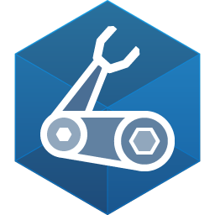
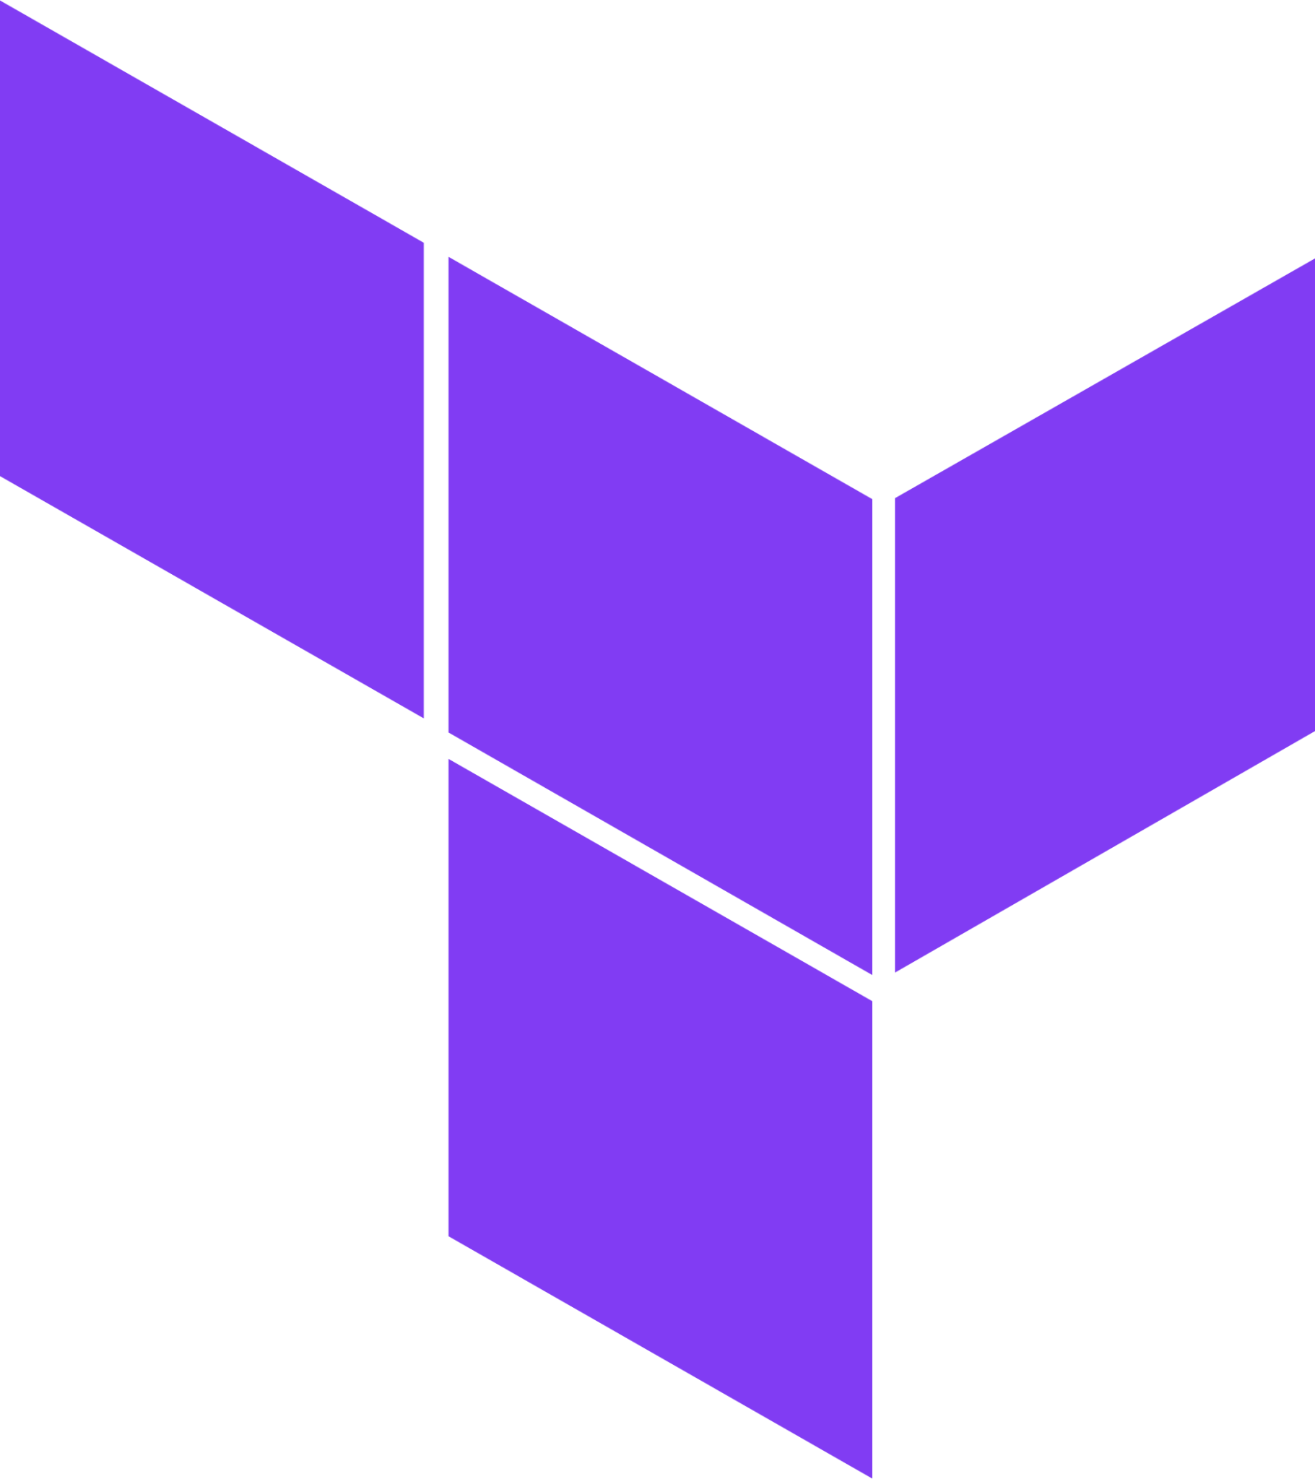
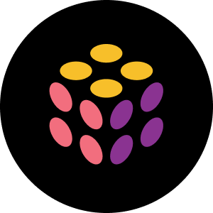

Introduction to Azure Deployment Environments
Infrastructure-as-code Template Catalog
On-Demand Environment
Sandbox Environment
Azure Mappings
Dev Infra Teams
Create templates and map projects to Azure subscriptions, identities, and permissions
Subscription
Developers
Deploy environments using templates based on current stage of development
CI/CD Pipeline Environments
Identity
Permissions
Notes:
Azure Deployment Environments essentially help development teams to quickly and easily spin up app infrastructure using project-based templates that establish consistency and best practices while maximizing security. This on-demand access to secure environments accelerates the different stages of the software development lifecycle in a compliant and cost-efficient way.
A deployment environment is a collection of Azure infrastructure resources defined in a template called an environment definition. Developers can deploy infrastructure defined in the templates in subscriptions where they have access, and build their applications on the infrastructure.
Platform engineers can create and manage environment definitions. To specify which environment definitions are available to developers, platform engineers can associate environment definitions with projects, and assign permissions to developers. They can also apply Azure governance based on the type of environment, such as sandbox, testing, or production.
The following diagram shows an overview of Azure Deployment Environments capabilities. Platform engineers define infrastructure templates and configure subscriptions, identity, and permissions. Developers create environments based on the templates, and build and deploy applications on the infrastructure. Environments can support different scenarios, like on-demand environments, sandbox environments for testing, and CI/CD pipelines for continuous integration and continuous deployment.

Slide 7
What’s new in Azure Deployment Environments
Support for Pulumi, Bicep, and Terraform
Build you own custom container image or use the provided language container to publish templates.
Project-based catalogs.
Platform Engineers can provide project-specific templates or allow dev teams to customize templates
Notes:
Support for Pulumi: In addition to being able to use Arm, Bicep and Terraform, customers will be able to perform deployments using Pulumi, another popular IaC framework. Customers will be able to build their own container image by leveraging the published guidance, or directly leverage the sample container image published for Pulumi. This feature is in preview.
Project-based catalogs: Platform engineers will be able to provide project-specific templates or enable dev teams to directly customize the templates used to self-serve app infrastructure. This feature is in preview.

Slide 8
Demo time!
Let’s do a quick tour of Dev Box and Azure Deployment Environments!

